Slide 1
CS 591 IG
Logistics

Slide 2
CS591 IG: Distributed Systems
Goals
Read, present and have deep discussions on state-of-the-art research
Generate ideas
Improve quality of submissions
Learn about academic careers in Systems
How?
1 student compares and contrasts two related papers
2 students explore an area with four related papers
Present your work for feedback
Students present tools (e.g. build tools)
1 credit

Slide 3
All topics in distributed systems
AI/ML
Consensus/Blockchains
A PL approach to systems
Systems for ML
ML for systems
Verified Systems
Performance & Observability
IoT/Edge
Microservices
OS
…

Slide 4
Suggestions?
Topic suggestions?
Ideas to incorporate in systems seminars?

Slide 5
How are we going to do this?
Good talks
Tell a story, simplify, get feedback
Deep discussions?
Bring yourselves, not your screens (Optional)
Ask questions even if you think they are too simple
Submissions quality
Highlight high-quality presentations/visualization/writing in papers
Old idea, great presentation: Making Sense of Performance in Data Analytics Frameworks (https://www.usenix.org/system/files/conference/nsdi15/nsdi15-paper-ousterhout.pdf)

Slide 6
How? Cont.
Generating ideas
Read and discuss
Build strong foundations in new areas where you hope to find a project – Jennifer Widom
Remove fundamental assumptions from classic problems and check if you have a research problem – Jennifer Widom
“If you're not prepared to be wrong, you will never come up with anything original” – Ken Robinson
The most popular talk on Ted to date. (https://www.ted.com/talks/sir_ken_robinson_do_schools_kill_creativity?referrer=playlist-the_most_popular_talks_of_all)
Nobel Prize-winning scientist Frances Arnold retracts paper (https://www.bbc.com/news/world-us-canada-50989423)
“There is no such thing as failure, only feedback”

Slide 7
How? Cont.
Academic Careers in Systems
Look for advice through Indy and Tianyin

Slide 8
How? Cont.
Academic Careers
The world of academic Twitter

Slide 9
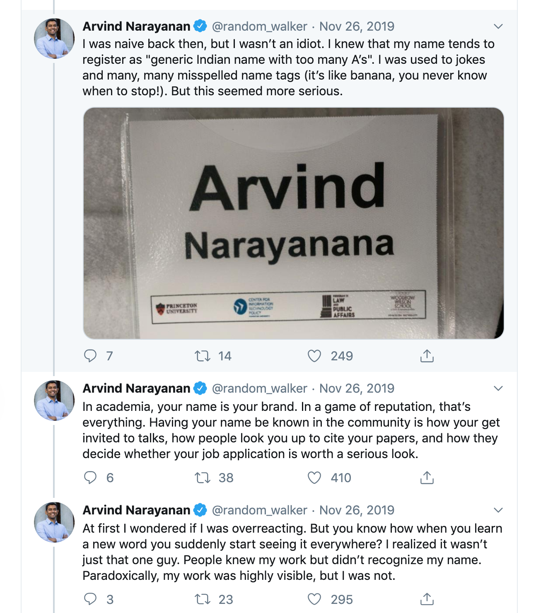
How? Cont.
An excellent avenue for networking outside of conferences
Gain visibility
People are happy to respond to tweets with questions or comments

Slide 10
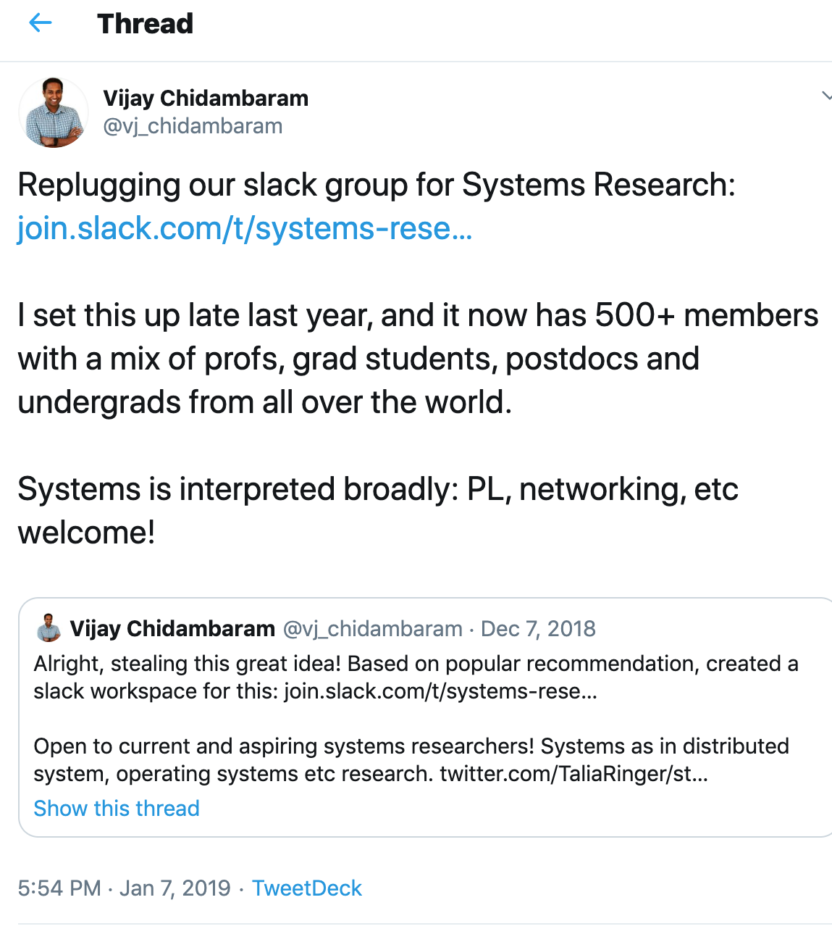
How? Cont.
Academic Careers
Resources for networking,
advice & opportunities

Slide 11
To do
Speaker for next seminar?
Send me an email with your topic of choice and tentative week.

